Slide 1
The Epic
From the Dark Age of Greece came oral epic poetry that served as the raw material for Homer’s sophisticated epics, the Iliad and the Odyssey. These two works deal, respectively, with the Greek conquest of Troy and the wanderings of the hero Odysseus after the Trojan War. The Homeric epics convey such values of ancient Greek culture as physical bravery, skill, honor, reverence for the gods, and intelligence.

Slide 2
Lyric Poetry
Of all the genres of Greek literature, lyric poetry loses the most in translation. Specifically, it loses its musical quality—lyric originally meant “sung to the lyre.” Nevertheless, Greek lyric poets like Sappho influenced the Roman poets and still influence today’s writers.

Slide 3
Philosophy
In the fifth century B.C., the philosopher Socrates developed a method of uncovering truth by asking probing questions. Socrates’ most famous follower was Plato, who recorded the dialogues that show his master practicing the Socratic method. Plato’s vision of a realm of changeless, perfect forms that are imperfectly reflected in this world attracted some of the finest minds of later generations. Aristotle, Plato’s most famous student, pioneered in developing logic, zoology, psychology, and many other arts and sciences. His work was a dominant force in Western culture for almost 2,000 years and still influences philosophy.
The Romans admired Greek philosophy and helped make it the basis for Western thought (which includes ideas that spread to America). In fact, some scholars have half-humorously referred to the Western philosophical tradition as a 2500-year disagreement between Plato and Aristotle!

Slide 4
Tragedy
Greek drama developed in connection with religious rituals and reached its peak in fifth-century Athens. Tragedies, which chronicled the downfall of a noble person, raised difficult questions about justice, evil, and the reasons for human suffering. In keeping with its religious origin, tragedy provided an emotional rather than a philosophical resolution for the questions it raised.
As a means of making the audience feel purged or cleansed, Greek tragedy aroused in them the powerful emotions of pity for the tragic hero and awe for his or her fate.
In order of birth, the three greatest Greek tragedians are Aeschylus, Sophocles, who wrote Oedipus the King; and Euripides. Although the surviving Greek tragedies are among the best works of world literature, we have available only a small percentage of the dramas these men actually wrote.

Slide 5
The Morality of Music
When rock-and-roll exploded onto the scene in the 1950s, some people claimed it was immoral and should be banned. They argued that the “wild” rhythms of rock would encourage wild behavior. A similar debate about the morality of music took place more than 2000 years ago in ancient Greece. This debate, however, focused on Greek musical scales, called modes, rather than on rhythms.

Slide 6
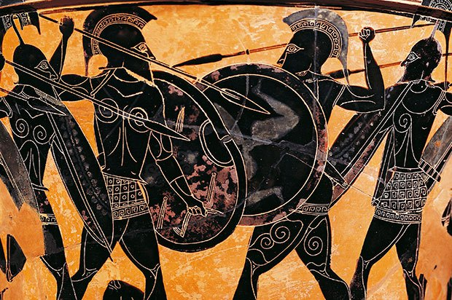
Scales and modes are sets of notes that are separated by definite intervals. Each Greek mode had seven notes. Also, the names of the modes were associated with groups and regions. The Dorian mode, for instance, was linked with the Dorians, a tribe that had conquered part of mainland Greece. The Lydian mode was linked with Lydia, a western kingdom in ancient Asia Minor.
These regions and the modes named for them had definite meanings for the Greeks. The Dorian mode, linked with a warlike area, was regarded as strong and manly. Songs composed in this mode were suitable for inspiring soldiers. By contrast, songs in the Lydian mode—named for Lydia—viewed as a corrupt place—were suitable for feasts.

Slide 7
In Book III of the Republic (c. 360 B. C.), the Greek philosopher Plato joined the debate about music. He warned against the influence of the Lydian mode, which seems to have been the rock music of its time. Plato banned these songs from his ideal republic because they made men “soft” and encouraged “drinking.” He favored the Dorian mode, which was “warlike” and sounded “the note or accent which a brave man utters in the hour of danger…”
If he were alive today, what would Plato say about heavy metal, hip hop, or rap?

